Slide 1
To be discussed
ANN training
What is creating the offset
Additional identification

Slide 2
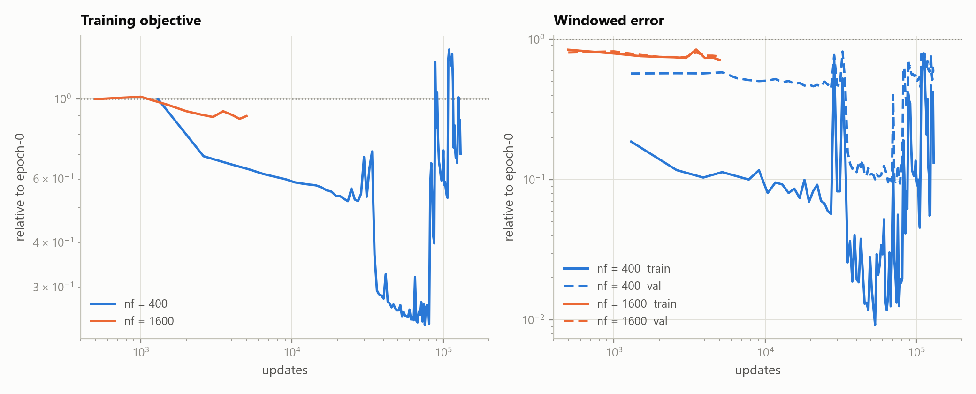
ANN only training

Slide 3
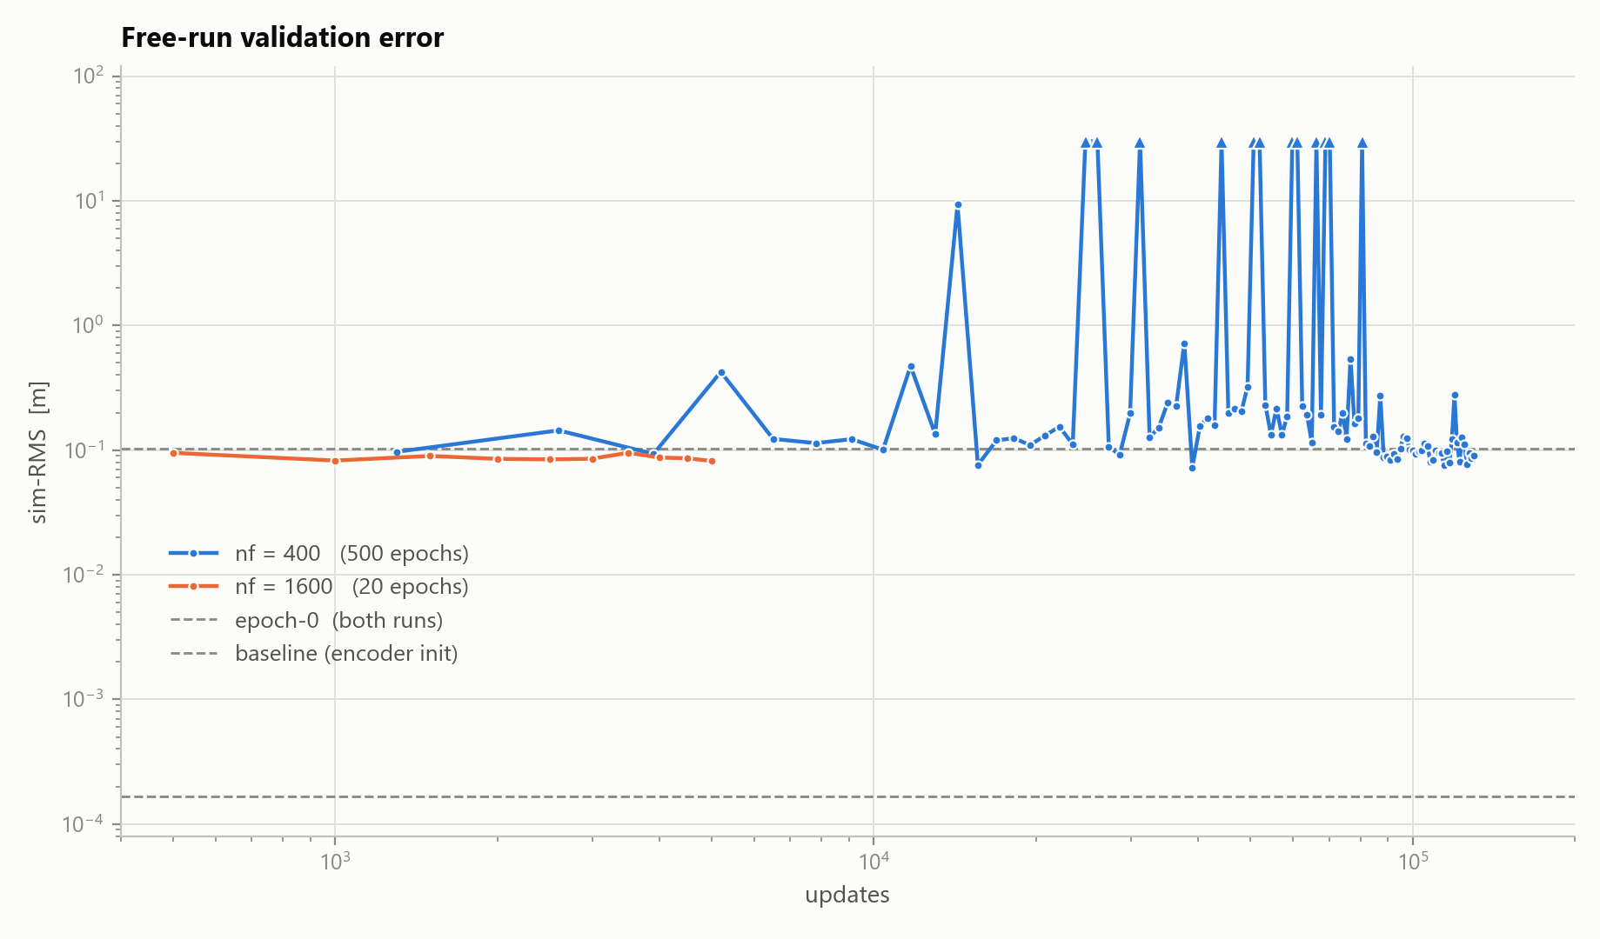

Slide 4
What is creating the offset?

Slide 5
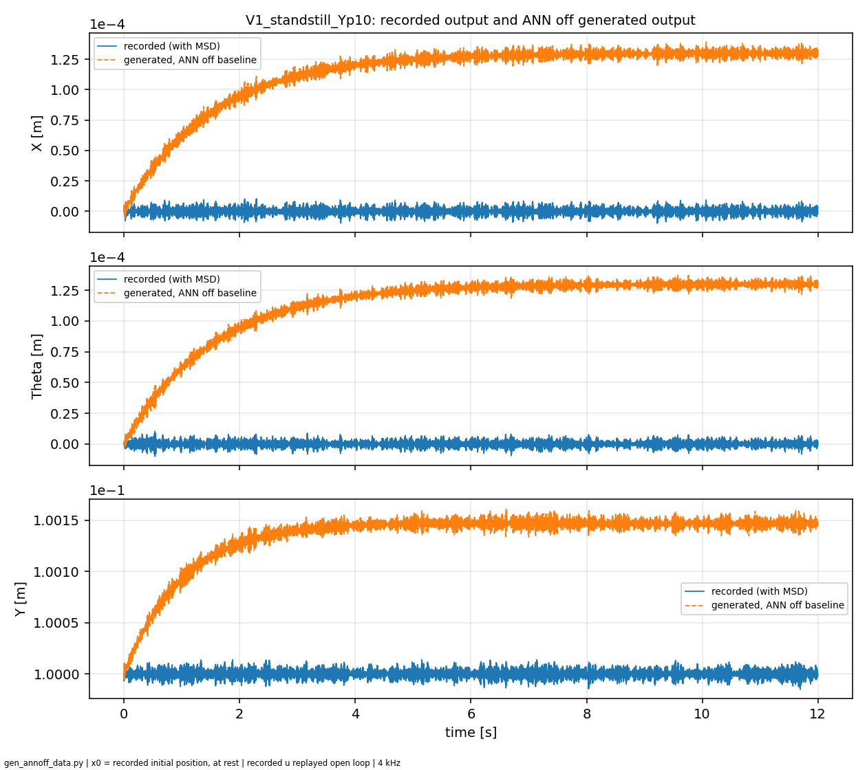
Mismatch model and data from system with MSD

Slide 6


Slide 7


Slide 8
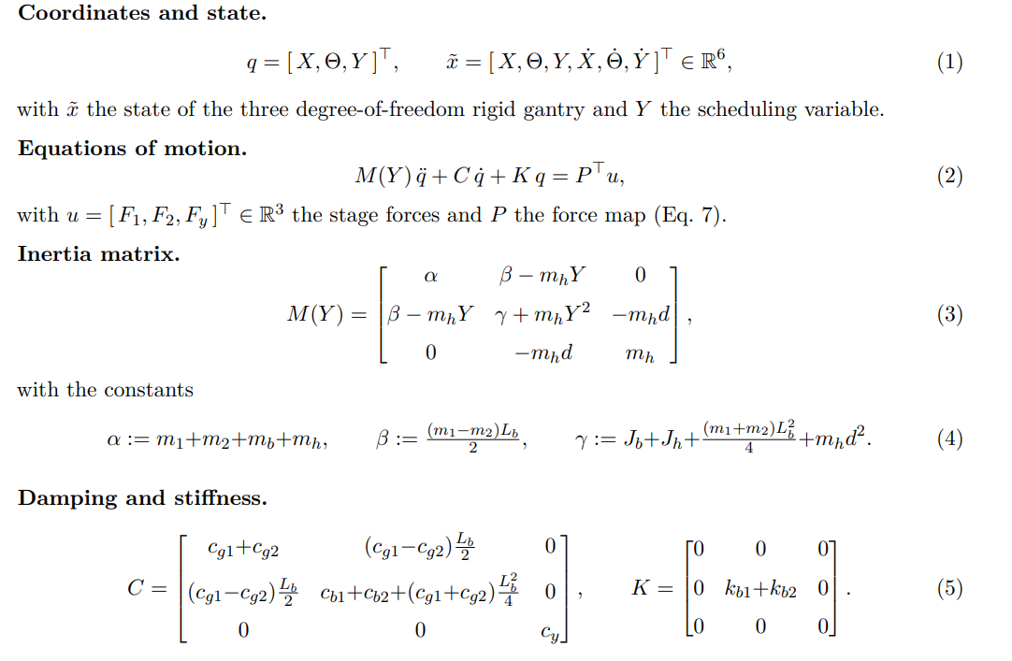
Baseline model

Slide 9
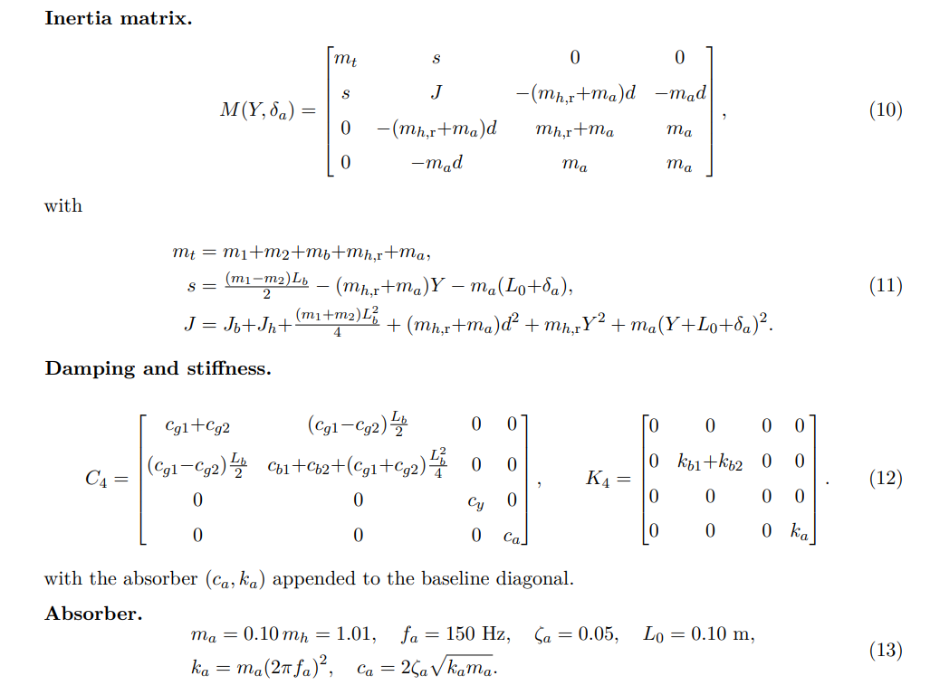
System with MSD

Slide 10
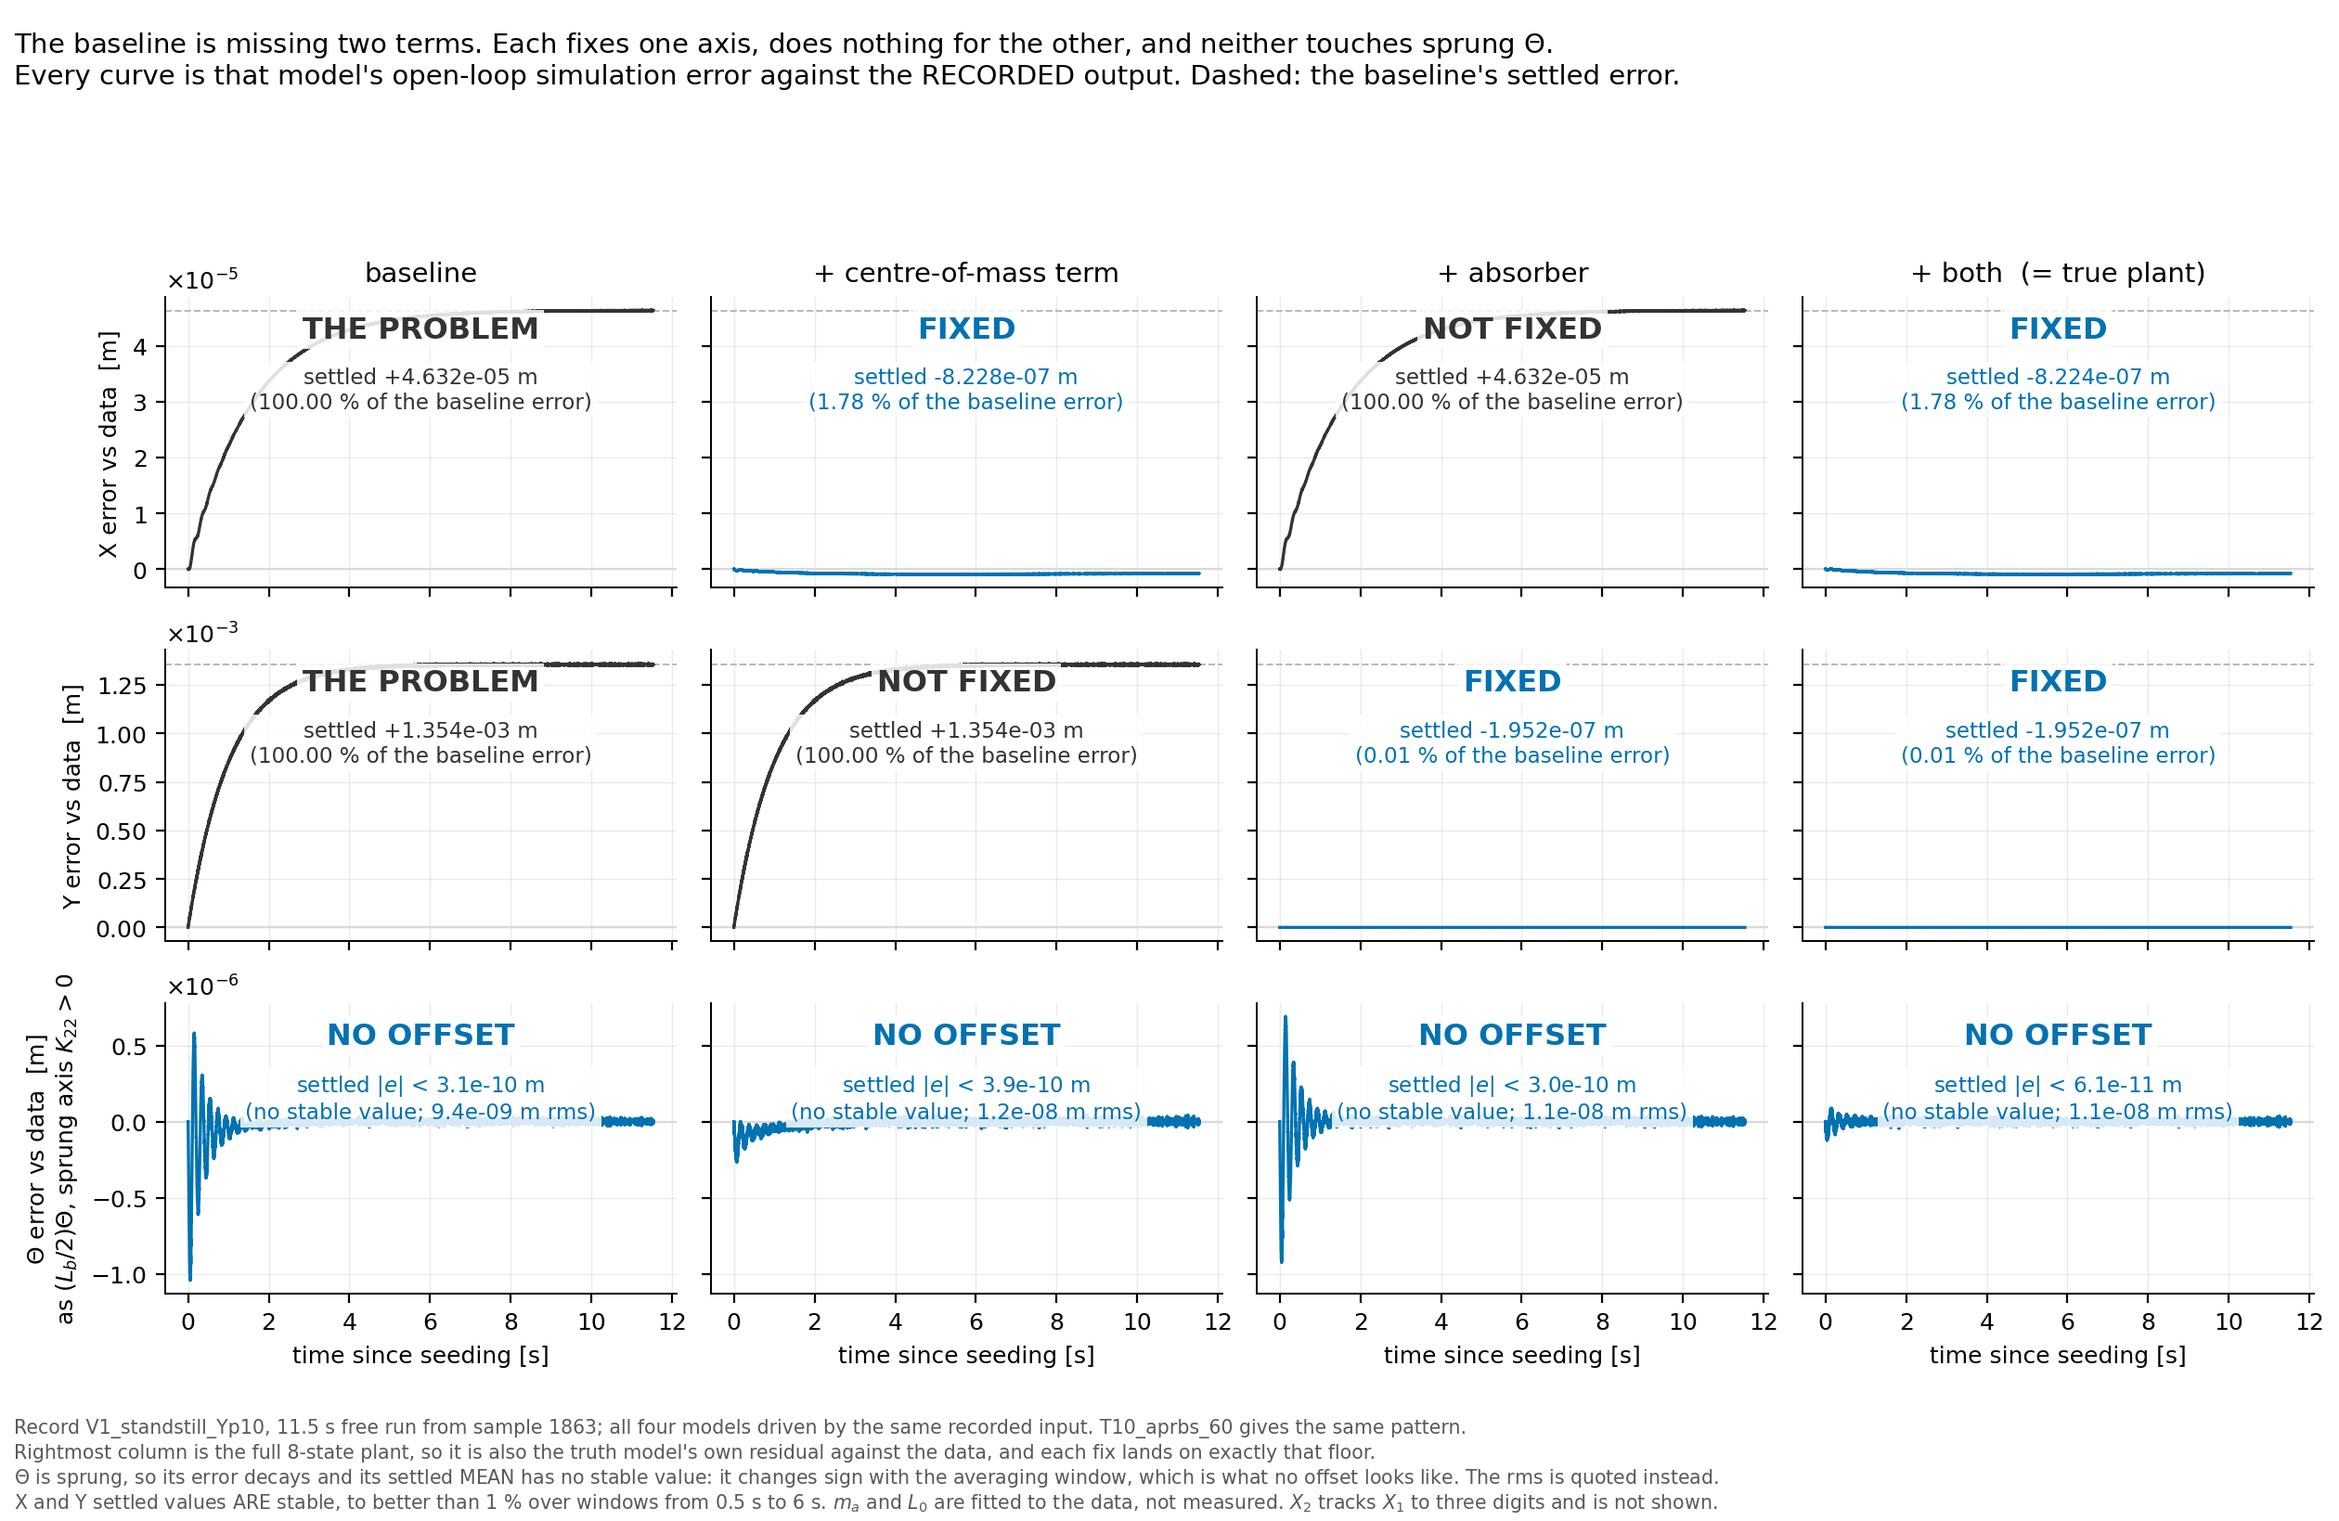

Slide 11
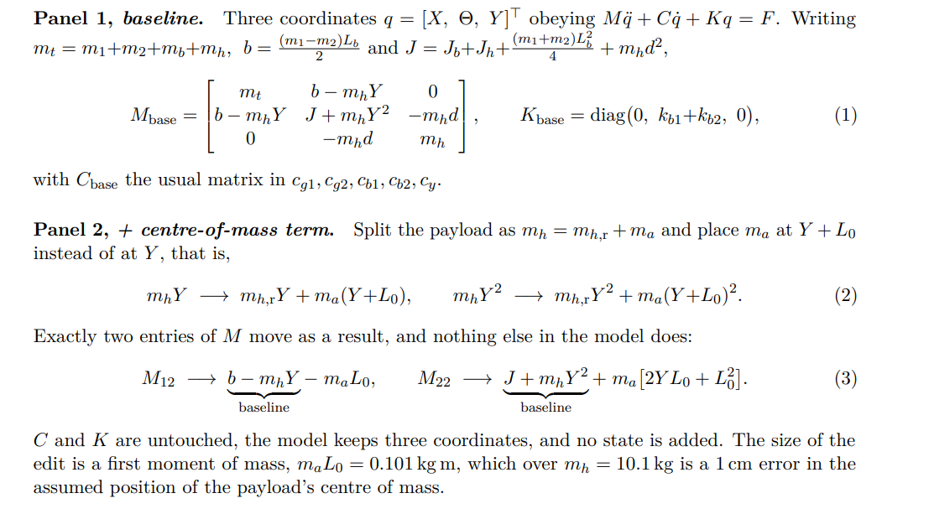
Notes:
X and Y have no springs.
Nothing pulls those stages back to a set position, so any error the model makes just stays there. Theta does have springs, so whatever happens to it, it comes back. That is K11 = K33 = 0 and K22 > 0.
Centre of mass, panel 2, fixes X
The baseline assumes the payload's mass sits in slightly the wrong place, off by about 1 cm. Whenever the bridge twists, mass in the wrong place produces the wrong sideways force. A wrong force on a free axis leaves the stage in the wrong place, and it stays there.
Absorber, panel 3, fixes Y
In the real machine a small part of the payload sits on a spring and can move by itself. When we start the replay it is already moving. The baseline has no such part, so it cannot know that. In reality that moving mass pushes the Y stage as it settles down. The baseline never receives that push, so Y ends up in the wrong place, and stays there.

Slide 12
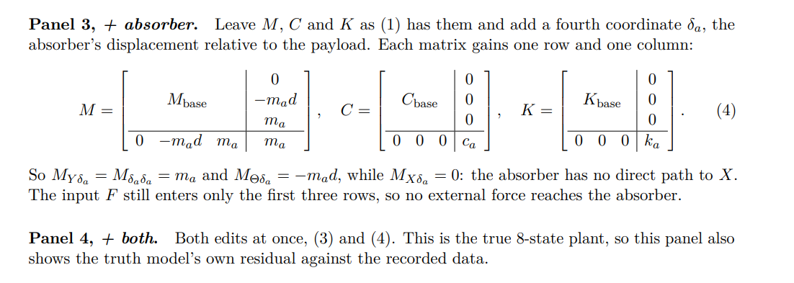
Notes:
X and Y have no springs.
Nothing pulls those stages back to a set position, so any error the model makes just stays there. Theta does have springs, so whatever happens to it, it comes back. That is K11 = K33 = 0 and K22 > 0.
Centre of mass, panel 2, fixes X
The baseline assumes the payload's mass sits in slightly the wrong place, off by about 1 cm. Whenever the bridge twists, mass in the wrong place produces the wrong sideways force. A wrong force on a free axis leaves the stage in the wrong place, and it stays there.
Absorber, panel 3, fixes Y
In the real machine a small part of the payload sits on a spring and can move by itself. When we start the replay it is already moving. The baseline has no such part, so it cannot know that. In reality that moving mass pushes the Y stage as it settles down. The baseline never receives that push, so Y ends up in the wrong place, and stays there.

Slide 13
Fix 1, the centre-of-mass fix. Keep the payload solid, no wobbling allowed, but move it to where the mass actually is. Because 1.01 kg of the 10.1 kg sits 10 cm further out, the true balance point of the payload is 1 cm further out than the baseline assumes. This fix is just telling the model the correct balance point. Nothing new is added, one number is corrected.
Fix 2, the absorber fix. Give the model the wobbling part: the extra 1.01 kg, its spring, and the fact that it can move by itself. This is not a corrected number, it is a whole extra moving part the baseline did not have.

Slide 14
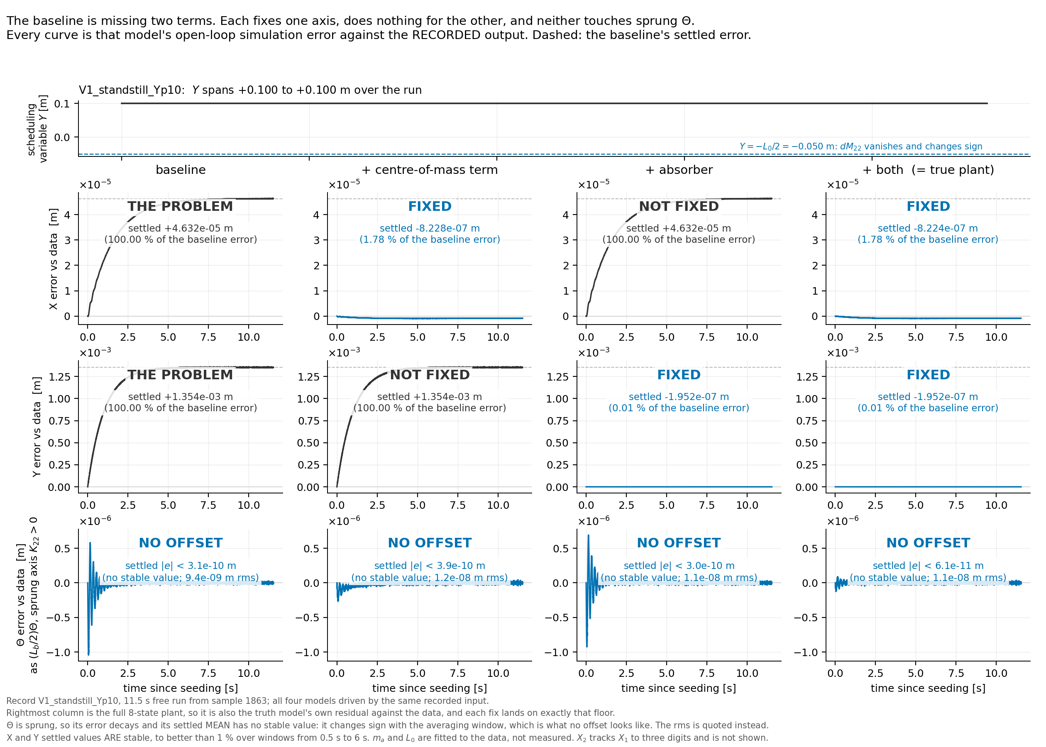

Slide 15
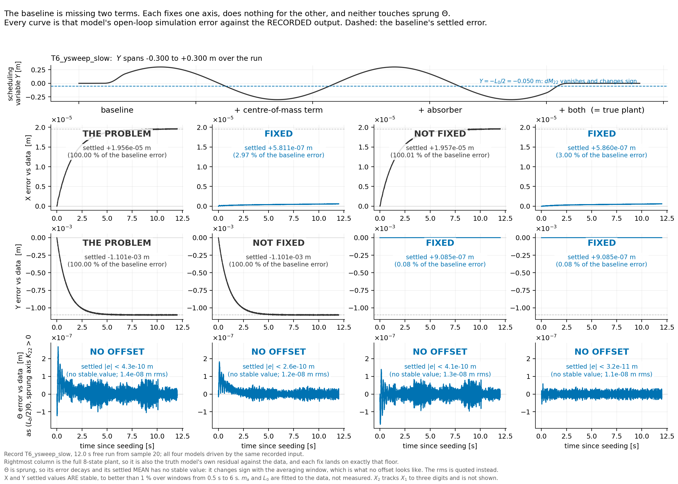

Slide 16
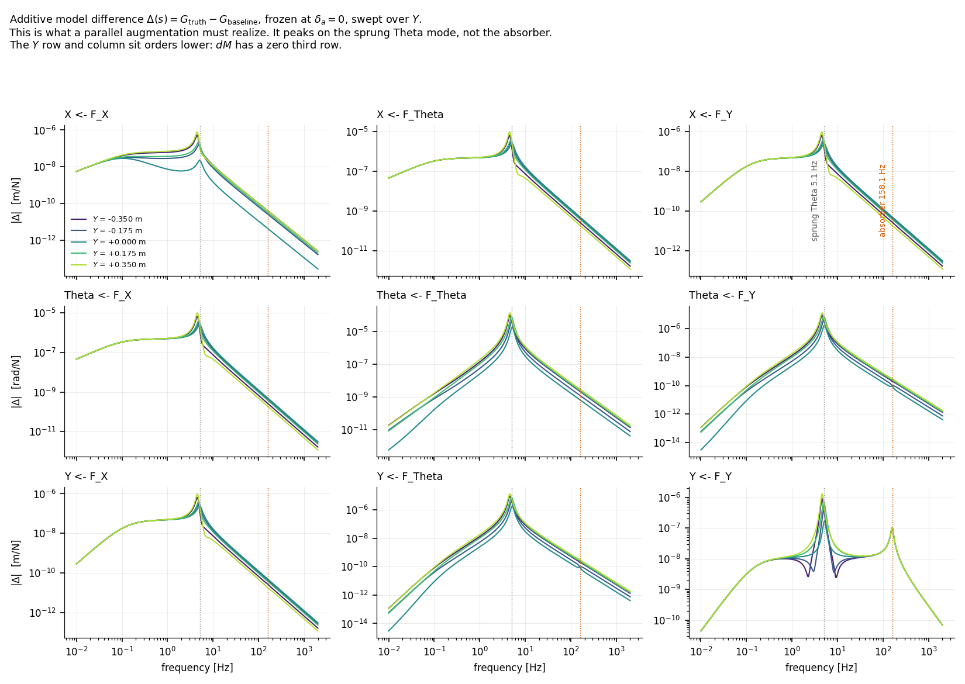
Notes:
dM =
[ 0 -ma*L0 0 ]
[ -ma*L0 ma*(2*Y*L0 + L0^2) 0 ]
[ 0 0 0 ]

Slide 17
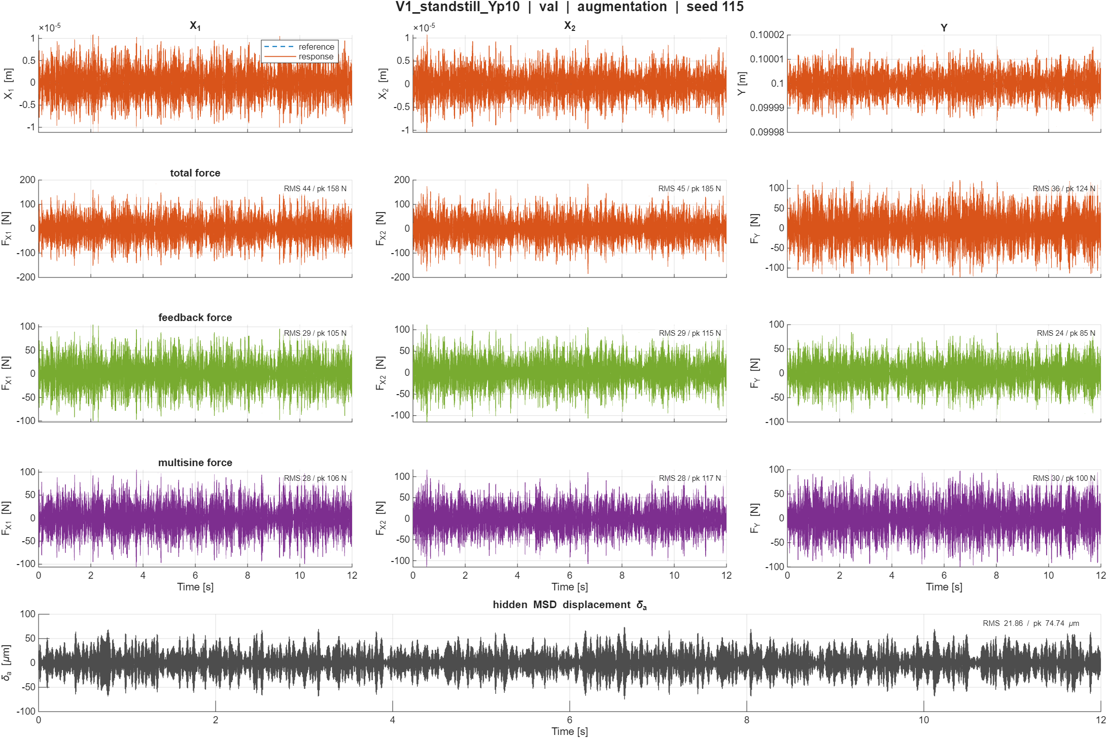

Slide 18
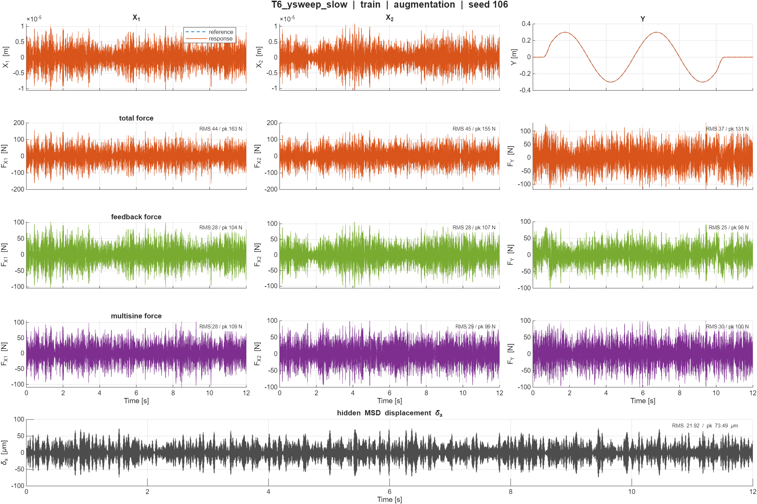

Slide 19
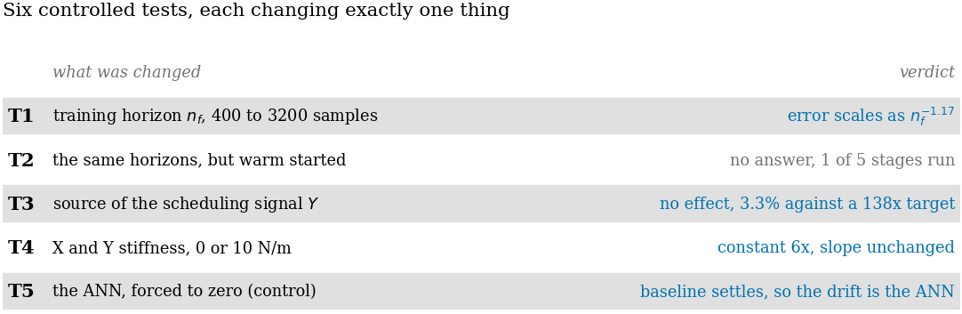

Slide 20
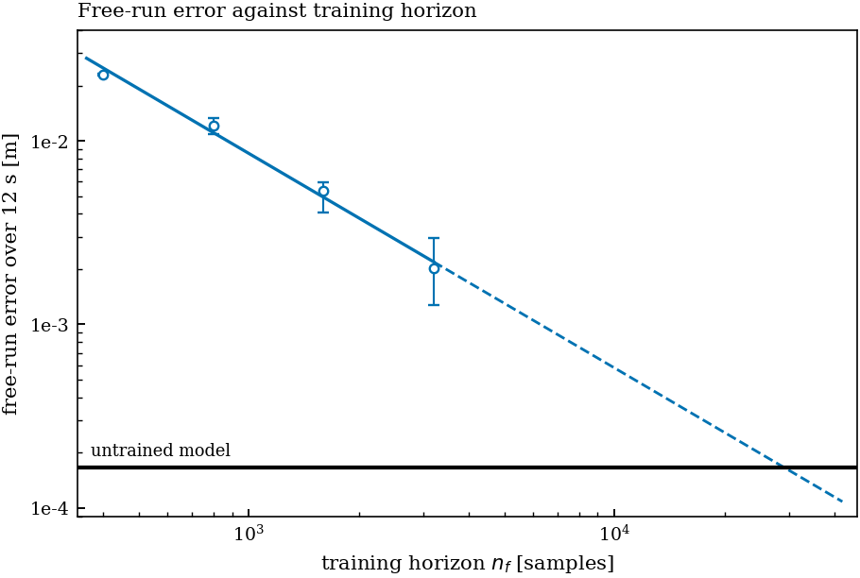

Slide 21
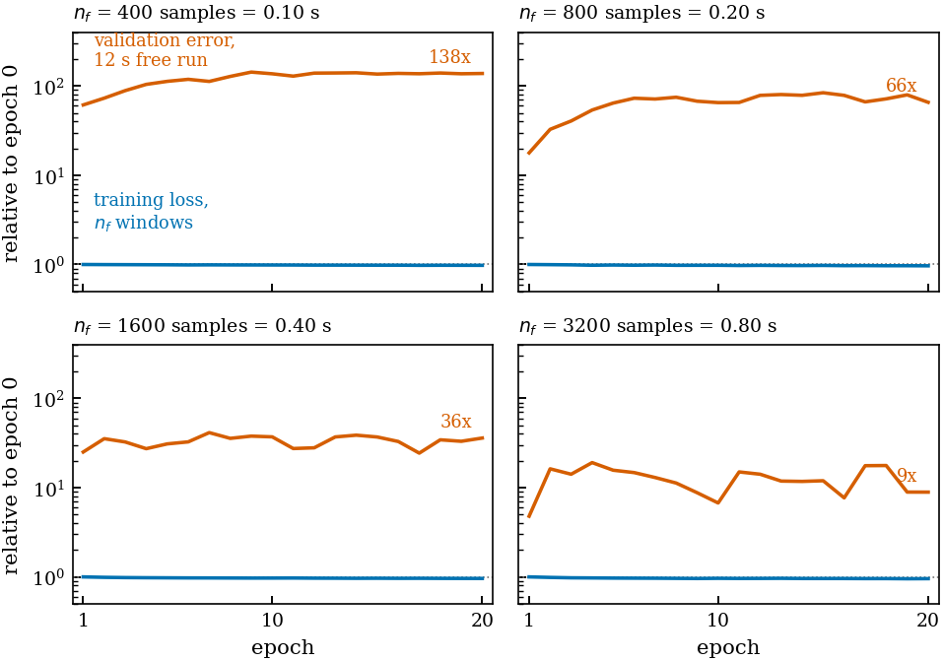

Slide 22
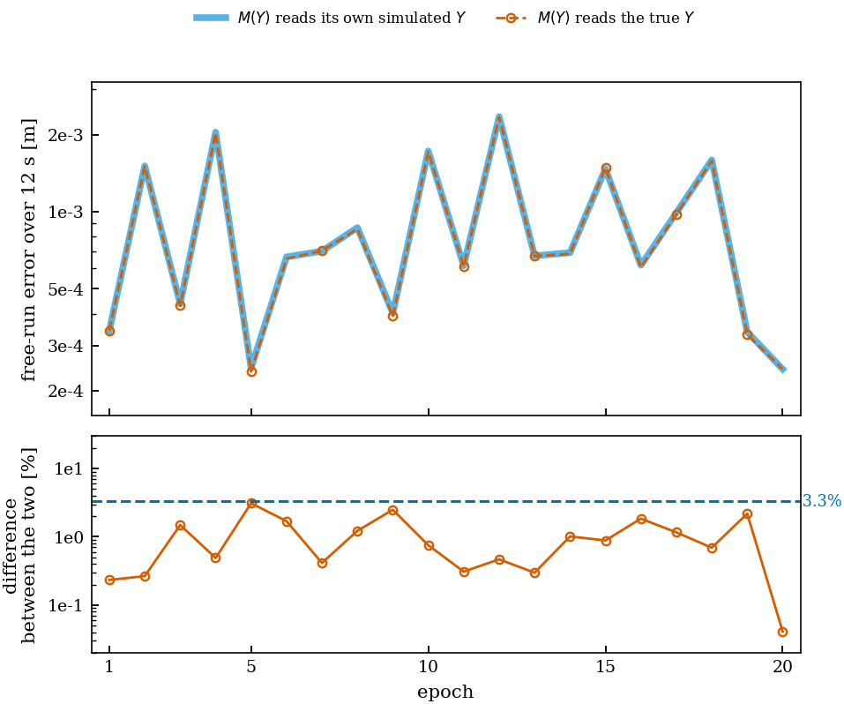
Is the small accumulating error in Y causing the drift?
Don’t schedule Y instead give it the true Y at that input
→ Does not fix the free run error

Slide 23
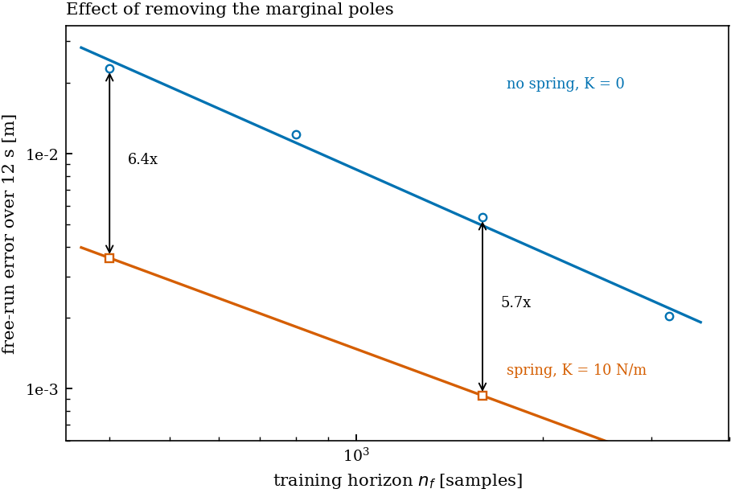
Adding stiffnes to X and Y to both the model AND system
→ Does not remove the offset

Slide 24
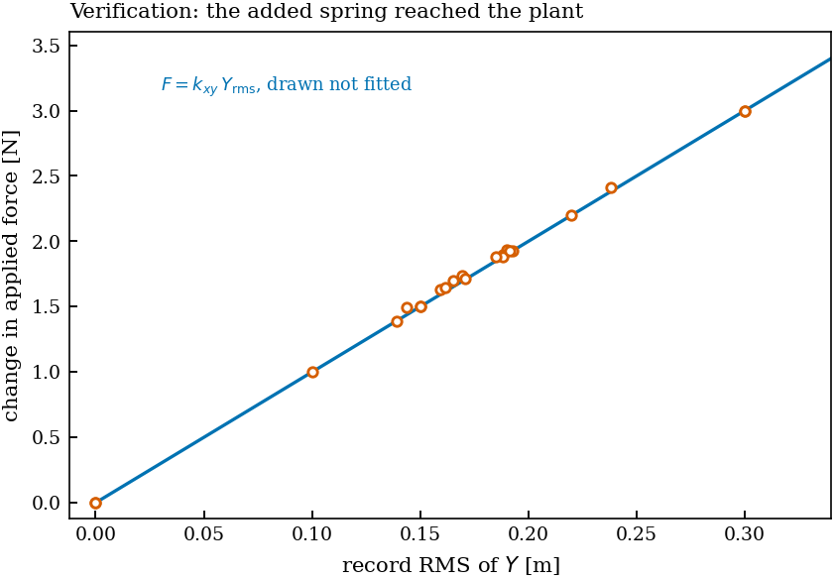

Slide 25
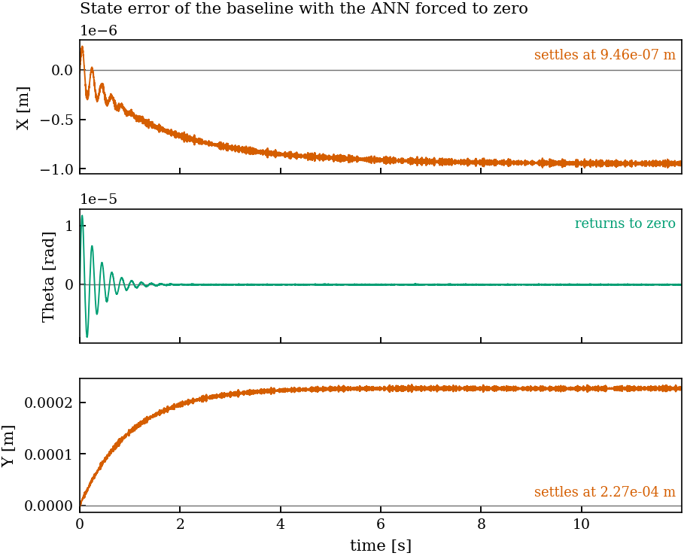

Slide 26
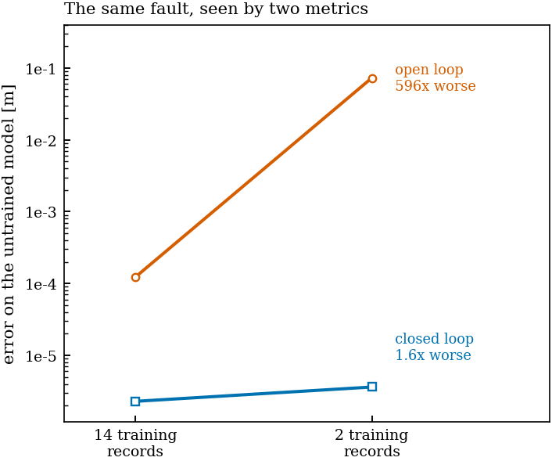

Slide 27
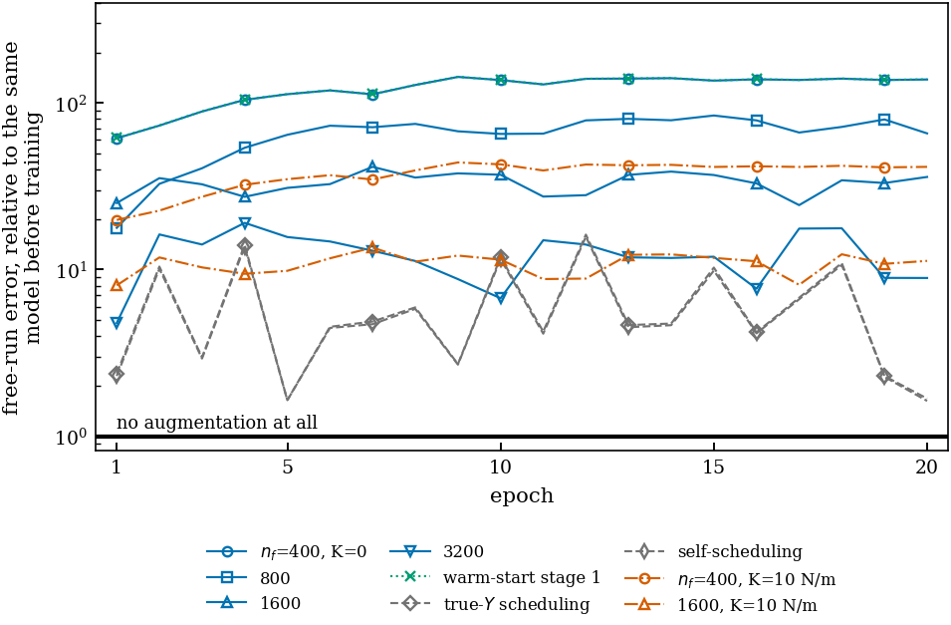

Slide 29
Next week
Jan vacation
Next week on vacation

Slide 30
New slidese
The probe separates the three possibilities cleanly, and the answer is not what I expected.max|eig(A)| = 0.99998251 so |eig - 1| = 1.755e-05x0 = 0 9.8895e-02 mx0 = least-squares optimal 2.5416e-02 m <- oracle init, best this model can dox0 = reconstructability map 5.4083e-01 mmap one-step output error on the TRAINING record: 3.0e-05 (normalised)My reconstructability map is correct. It reproduces the training record's output to 3.0e-05 normalised. The algebra, the deepSI input ordering and the time alignment all check out.But it is numerically catastrophic off the training record. x0_rec contains a component of -567 where the optimal is order 1. pinv(O_n) is ill-conditioned precisely because the poles are near 1: the observability matrix is nearly rank-deficient in the integrator directions, so on data the model fits badly the residual gets amplified ~500x. That is the 0.541 epoch-0, and it is a numerical defect I can fix with a regularised pinv.
The probe separates the three possibilities cleanly, and the answer is not what I expected.max|eig(A)| = 0.99998251 so |eig - 1| = 1.755e-05x0 = 0 9.8895e-02 mx0 = least-squares optimal 2.5416e-02 m <- oracle init, best this model can dox0 = reconstructability map 5.4083e-01 mmap one-step output error on the TRAINING record: 3.0e-05 (normalised)My reconstructability map is correct. It reproduces the training record's output to 3.0e-05 normalised. The algebra, the deepSI input ordering and the time alignment all check out.But it is numerically catastrophic off the training record. x0_rec contains a component of -567 where the optimal is order 1. pinv(O_n) is ill-conditioned precisely because the poles are near 1: the observability matrix is nearly rank-deficient in the integrator directions, so on data the model fits badly the residual gets amplified ~500x. That is the 0.541 epoch-0, and it is a numerical defect I can fix with a regularised pinv.

Slide 31
Coulomb friction sign or tanh?
- sign is exactly right everywhere the stage slides, which is almost the whole record, and wrong only on the set v = 0.
That is one point, and its error there is a modelling omission (it returns 0 where the law is set-valued), not a distortion.

Slide 32
ANN init problem?
It also answers your augmentation question with a concrete warning: if the ANN is allowed to influence the position poles, this same objective will move them from exactly 1 to about 1e-3 off, and the augmented model will end up worse than its initialisation. That is precisely what runs 71167 and 68458 recorded. I

Slide 33
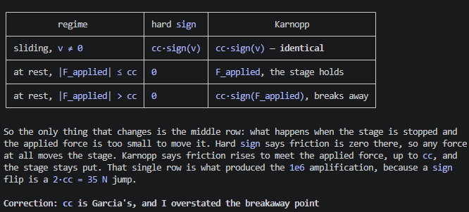
Coulomb issue hard sign
Decisive, and better than I expected.model X Theta Yhard sign (current) 1.071e+06 2.378e+06 4.586e+06karnopp V_EPS 3.27e-06 1.448e+00 1.222e-03 9.853e-04karnopp V_EPS 3.27e-05 1.472e+00 1.441e-03 1.527e-03karnopp V_EPS 3.27e-04 1.510e+00 1.576e-03 1.998e-03A 728,000x reduction on X, and the number it lands on is the important part: 1.47 against the frictionless system's 1.43 from the previous test. The stick state does not merely reduce the amplification, it restores the sensitivity of a smooth, well-behaved ODE. Friction stops costing anything in predictability.The heuristic is not load-bearing. V_EPS swept over two decades moves the gain from 1.448 to 1.510, a 4 % change. That was the thing that could have made this a bad trade, and it did not.So the e-6 floor was never physics and never an implementation gap. It was sign(0) = 0 letting an infinitesimal state difference produce a 35 N force step, and filling in the v = 0 case that Coulomb's law already implies removes it. With this, the replay floor should return to the 1e-09/1e-10 range we measured frictionless, which is at or below your train_param_recovery.py benchmark.
Garcia makes a simplification
  The deeper issue is that with hard sign, what we wrote is not a well-posed ODE at all.
Karnopp implementation else much worse than frictionless.
The honest caveat to carry forward is presliding, which Karnopp omits and which lives at the same length scale as the offsets, so it belongs in the limitations rather than in the code.

Slide 34
Fix
The floor test is the one that decides it, against these two anchors:frictionless truth (the target) X 5.37e-10 Theta 2.73e-11 Y 5.91e-09hard sign X 2.29e-06 Theta 2.56e-06 Y 2.23e-06Karnopp, buggy breakaway X 6.37e-06 Theta 4.62e-06 Y 6.18e-06
axis max |res| rms vs hard sign vs frictionlessX 1.4412e-09 8.3222e-10 1587.1x 2.7xTheta 6.8572e-11 1.7762e-11 37401.8x 2.5xY 8.7460e-09 3.3928e-09 254.6x 1.5x

Slide 35
Friction identifilibilty
without friction 3.7e-10 ... 5.1e-05 about 5 decadeswith friction 2.6e-08 ... 3.3e-06 about 2 decadesEvery 1 % parameter error, whichever parameter, produces a position offset of order 1e-06 m once friction is present. Without friction the same errors produce wildly different offsets depending on which parameter is wrong. Friction destroys the distinguishing signature between parameters, which is a statement about identifiability rather than about accuracy, and it bears directly on the parameter-recovery thread: on a frictional stage, a free-run position metric would struggle to tell which parameter is wrong, because they all look alike in the output.

Slide 36
Drift Y fix without absorber.
X still has an issue
Initial condition Y seems to cause the Y issue
That is finding F2, and it is the physically interesting half of the result. The absorber does cause a large error frictionless; it just causes a symmetric one that averages away. The offset only appears when something breaks the symmetry, and from a proper initial condition friction is the only thing that does.

Slide 37
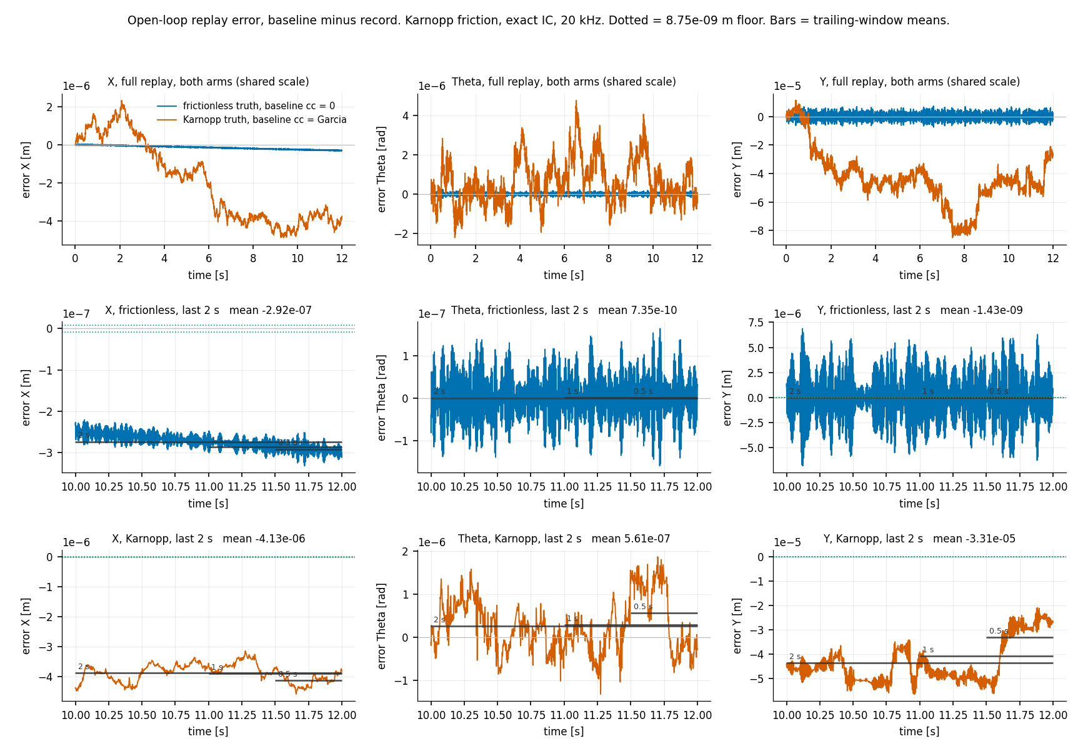

Slide 38
Centre of Mass difference
COM
That is worth knowing for a reason beyond this investigation: T10 is a training record, so the baseline's X error on training data is dominated by a static mass-matrix term. And we measured that the centre-of-mass correction removes 96.6 % of it on V1. If that carries to T10, then most of the largest error the augmentation currently sees on X is not a discrepancy to be learned at all, it is a term the baseline is simply missing and which could be put back analytically.

Slide 39
Need to fix Y for short windows with good initialization zero mean just oscillating without good init. We get the offset
Previously didn’t correctly do init velocity.

Slide 40
Enforce zero mean

Slide 41
Velocity issue with true init from finite difference
But for bppt we have an issue
With true inits it is zero mean
But with random init for the augmentation we cant fix this.w

Slide 42
With true physical init, is the short-window error zero-mean?
1. With true physical init, is the short-window error zero-mean? Yes — on all six states, and with and without the CoG fix. Newey-West HAC t on the 476 per-window means: exact-seed t (CoG on / CoG off)V1 X 0.09 / 0.09 Theta 0.11 / 0.51 Y -0.09 / -0.09 dX 0.21 / 0.09 dTheta 0.20 / 0.08 dY -0.12 / -0.12V3 X 0.56 / -1.19 Theta 0.67 / 0.66 Y -0.66 / -0.66 dX 0.49 / -1.22 dTheta 0.64 / 0.72 dY -0.68 / -0.68

Slide 43
V1_standstill_Yp10, 476 windows of 400 samples (nf = 0.100 s at 4 kHz)axis mean of SCATTER of in-window scatter/ corr with win means win means oscillation osc vDelta_a(0)X 2.718e-08 6.302e-07 3.009e-07 2.09x -0.103Theta -1.408e-08 1.158e-06 5.363e-07 2.16x +0.495Y -6.864e-06 1.045e-04 4.848e-05 2.15x -1.000Y mechanism: predicted slope -5.0000e-03 s observed -4.8271e-03 s (ratio 0.97)

Slide 44
For the encoder init its always dependent on the ann for the init of the additional states?

Slide 46
The CT model fits the training objective far better than DT. sqrt loss 0.585 → 0.310 → 0.291 in 300 updates. The DT arm was still at 0.79 after 900. That is roughly 2.7x better on the same objective with a third of the budget.

Slide 47
Partly, and the literature now lets me say which part. It resolves what is plausibly the binding problem: right now the ANN has nothing to win, because the absorber is about 1e-9 of the sim-RMS metric while the untrained baseline already scores 1.6e-4, so every gradient step can only do damage and every run has selected epoch 0. A cubic spring deflects the rigid-body trajectory itself, which makes epoch 0 beatable for the first time. Retzler et al. 2024, from your supervisors' own circle, is the measured precedent: on the same robot, augmentation beats ANN-only when the discrepancy is a static friction map and fails to when the data contains hysteretic presliding.

Slide 48
Why the previous target was unlearnable. The absorber is about 1e-9 of the squared metric while the untrained baseline already scores 1.66e-4 m. So the ANN's best possible gain was roughly zero and its damage potential was unbounded. Training had a strictly negative expected value, which is exactly why every single run selected epoch 0. That was never "the ANN cannot fit things", it was "there is nothing here worth the risk of touching".
Why the cubic spring is different, and it is not just that it is bigger. The ANN does not have to learn any dynamics. The baseline supplies the integrators exactly, by construction. Everything that killed the black box (Ribeiro's O(N) loss sensitivity at the unit circle, Asadi's N·Δ accumulation, needing to resolve |λ-1| < 2e-8) is about learning the marginal mode. Here the mode is given and the ANN only has to output a static scalar force as a function of Y, which is a state it already sees. A tanh MLP fits that in its sleep. So D-134's negative does not transfer to this target, and that is the actual point.

Slide 50
"Why does a small model error become a permanent offset rather than a transient?"Answer: because X and Y have no stiffness, K(1,1) = K(3,3) = 0, so two poles sit at s = 0. On such an axis any accumulated impulse of force difference becomes a permanent position shift, offset = impulse / damping. And both impulses have a closed form with nothing fitted:

Slide 53
On Gerben's plant, holding the last sample is worse than guessing the mean. The state is gone almost immediately, so the system forgets, so short-horizon accuracy transfers to long-horizon accuracy and SUBNET works. On the gantry it is inverted: holding the last sample is twice as good as the mean, because the system remembers, because it integrates.

Slide 54
"An unconstrained black box cannot free-run a marginally stable mechanical system, because the short-window objective it must be trained on is blind to the long-horizon behaviour it is scored on" is precisely the argument for augmenting a physical baseline instead. The black-box column failing this way is not an embarrassment in your results table. It is the reason the table exists.

Slide 56
Offset 2: the acquired offset. This is the gap.Epoch 0 to epoch 1: 1.66e-04 to 2.11e-02, 127x, with a bit-identical training loss. The ANN acquires a constant on rows that feed free integrators, and the deliverable charges for it.Why the framework is out of its validated regime. Jan's reference benchmarks, the MSD, Bouc-Wen and the cascaded tanks, are all asymptotically stable: every mode decays, no poles on the unit circle. On such a plant an unconstrained additive residual with a nonzero mean produces a bounded output error, because the DC gain from force to output is finite. The gantry in logical coordinates has K = diag(0, kb1+kb2, 0), so X and Y are free double integrators with poles at z = 1. There the DC gain from force to position is infinite, and a constant force error grows as f·t²/2. Between a 0.1 s training window and a 12 s free run that is an amplification of (12/0.1)² ≈ 14400.So the objective is nearly blind to the exact quantity the metric amplifies most. Nothing in the framework bounds it, because on the systems it was built and validated for, nothing needed to. That is a clean statement of the gap and it is checkable: it rests on a property of Jan's benchmarks, worth confirming against his papers before it goes in the thesis.

Slide 57
One thing worth raising with your supervisorThe real machine runs in closed loop, and ruleOfThumb has a pole at the origin, so it rejects exactly the DC that the open-loop free-run metric punishes. A 12 s open-loop free run on a plant with rigid-body modes charges the model for a quantity the controller would remove. That does not make free-run simulation the wrong metric, it is standard and it is in the research plan, but it does mean the metric and the deployment condition disagree specifically on the failure mode you are fighting. Better to put that on the table explicitly than to keep fixing the model against it.If the framing helps: the thesis has a stated contribution (orthogonal projection extended to LPV/MIMO/LFR) and this is turning into a second, forced one, namely what augmentation requires when the baseline contains rigid-body modes. That is a real gap in Jan's framework, not a failure of your implementation of it.

Slide 58
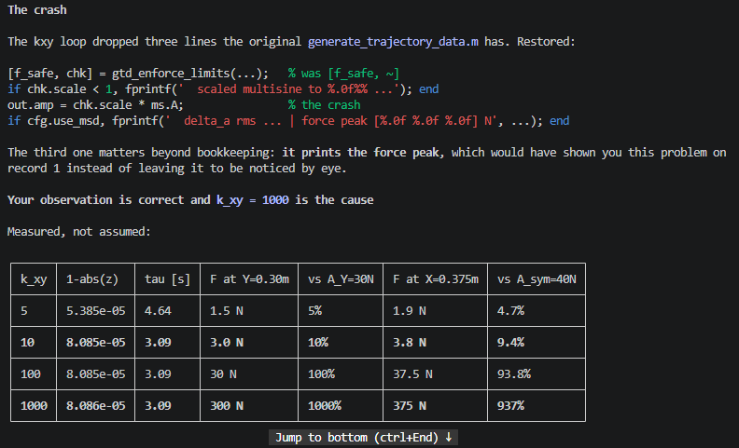
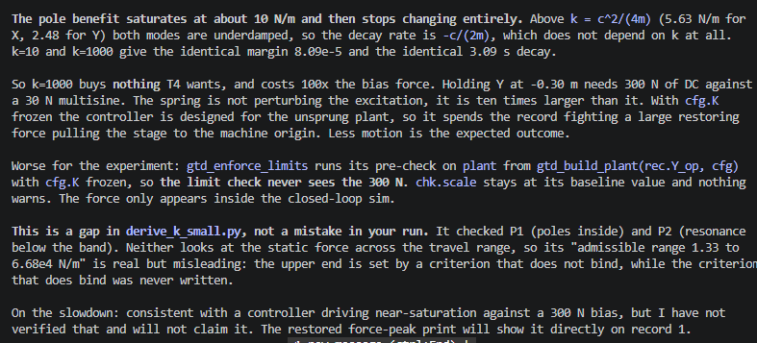

Slide 59
And it does not transfer. Telica is closed-loop logs only. Anything you conclude from open-loop-generated data would not carry to the deliverable.

Slide 60
What you actually want is already available in the data you haveYou want to see the overlay with only the 158 Hz difference and no level shift. You get that by seeding the comparison at an instant where the absorber is at rest, not by re-recording. My ablation measured this directly: with δ = δ̇ = 0 at the seed, the Y offset drops from 2.53e-03 m to 5.67e-07 m, a factor 4450, and it stays at 5.67e-07 for every seed time I tried. Once you start from rest, no offset accumulates later, even though the absorber is fully excited during the active window. That is exactly the "zero-DC, bounded-impulse residual" behaviour the framework assumes.

Slide 61
Stride issue?? no
But here is the part that matters, and it cuts against the intuition: δ̇(t_k) is a zero-mean 158 Hz oscillation, and stride 10 samples it densely and uniformly. The stride spacing is 2.5 ms against an absorber period of 6.33 ms,

Slide 62
Rigid body window length issue
So the window resolves the thing you want to learn about 16 times over, and resolves the rigid-body settling about a tenth of once.
An acquired constant force is 14400x under-weighted. On a K = 0 axis a constant force gives f·t²/2, so the ratio between the metric horizon and the window is (12/0.1)² = 14400. That is the acquired-DC problem, and it is a pure function of the window length.

Slide 63
yes this kind of makes sense. but i keep repeating that we have an offset, do you agree? and jan's framework cant capture that. so we actually DO have to capture an offset or am i wrong
Where you are right: there is an offset, it is large (2.5e-03 m on V1 against a 4.4e-06 m signal), and the ANN block as configured cannot produce it.Where I would push back: "so we have to capture an offset" treats the offset as part of the residual to be learned. It is not. The ablation says it is entirely an initial-condition effect: set δ = δ̇ = 0 at the seed and it drops 4450x, from 2.53e-03 to 5.67e-07 m. There is no persistent force in the plant producing it. So the goal is not to reproduce the offset, it is to not have it, by getting the initial state right.What is actually broken is narrower and more fixable than "the framework lacks a capability". The framework has two routes to an offset and both are blocked by the same thing:- The encoder route. Its job is the initial state, including the two augmented latents. It already removes about 70 % of the offset (2.11e-04 against 7.33e-04 for true-x0 seeding), but it does that by biasing dY, not by estimating the absorber. x_enc_ann in run 71167 is identically zero over all 48000 samples.- The ANN route. A force can produce a permanent offset on a K = 0 axis, via its impulse: Δx(∞) = ∫f dt / c. The ANN's inputs are [x(8), u], which include x[6] and x[7], the augmented latents. If those tracked δ and δ̇, the ANN could emit the corrective impulse.
Where your point becomes structurally true, and this is the version I would take to your supervisor. At the project's own noise levels the estimate collapses: δ̇ is unrecoverable by 50x at SNR 60 dB, 89x at 55, 161x at 50, and no window length fixes it. On real Telica data there is no way to estimate the absorber state, so the offset is irreducible and then the framework genuinely has nothing that can handle it. That is a real gap in applying Jan's framework to a plant with rigid-body modes and an unobservable internal coordinate, and it is a defensible finding.

Slide 64
2. A clean first-order settle. It rises smoothly with τ = 1.01 s and then holds. That is the shape of an initial-condition transient.

Slide 65
That is why every simulation in the pipeline starts there rather than at sample 0.And it is the part that matters for your earlier objection. The pipeline structurally cannot seed at t = 0. It has to wait 17 samples for the encoder, and by then δ̇ is already at 2.5e-02 m/s, essentially its full RMS. So the t = 0 exact-IC seeding is a diagnostic that isolates the mechanism, not a fix the pipeline can adopt. The only fix available inside the pipeline is to make those 17 samples of history actually produce δ and δ̇, which noiselessly they can, to 0.43 %.

Slide 66
- the offset belongs to the initial condition and cannot be fixed by a parallel force block,- the ripple belongs to the dynamics and is exactly what Jan's framework is built for.

Slide 67
What the three say togetherThe drift is introduced by the augmentation (T5), is not LPV self-scheduling (T3), and its magnitude is governed by the training horizon with a clean power law (T1). The one remaining untested cause hypothesis is structural marginal poles, which is exactly T4.And the horizon fix is not reachable by cold start, which is precisely why T2's warm-started ladder exists.

Slide 68
PHY_IX is 0..5. So rows 6 and 7 receive only the ANN's output. There is no identity term carrying x_k[6:8] into x_{k+1}[6:8]. Concretely:
They have no memory and no integrator. Whatever the encoder estimates for δ and δ̇ at k = K0 is overwritten at the very next sample. And since the ANN is zero-initialised, they are exactly 0.0 forever, which is what x_enc_ann shows and why r2_rollout_raw and r2_rollout_linmap are both exactly [0, 0] in the results file.

Slide 69
What it has to learn is the hard case. To hold the absorber mode, the learned map needs a Jacobian on those rows with eigenvalues at z = exp(s·ts) for s = −52.4 ± 992j at 4 kHz, i.e. |z| = 0.987 rotating 14.2° per step, about 25 samples per period. Learning a near-unit-modulus rotation from a zero initialisation through a tanh MLP is the classic difficult RNN regime, and it is being asked for over 0.1 s windows, which is 16 periods.

Slide 70
What that means for T4The sprung curve is the unsprung curve shifted down by a constant, with the same nf^-1.17 slope. So the spring and the horizon are independent contributions, and marginal poles are not why the horizon requirement is extreme.
T4's answer is therefore: marginal poles are a real contributor worth ~6x, but they are not the cause and removing them does not change the character of the failure. The horizon gap that T1 quantified remains the dominant, separate mechanism. The signature is unchanged at both rungs, a 0.3% move in the objective buying a 6 to 12x free-run degradation within two epochs.

Slide 71
Conclusion1. There are two error phenomena, and conflating them has cost timeT5 drew the line and it should be held: the baseline plus encoder produces a bounded offset that settles, while the augmentation produces unbounded drift. Almost everything I did this session belongs to the first, and the first is not the problem.2. The bounded offset is now closedΔY(∞) = ma·δ̇(t₀)/c_y, validated at R² = 1.000000 (V1) and 0.999997 (T10) against an unfitted line over 60 seed instants each. It is an initial-condition deficit: a 6-state model cannot hold the absorber's momentum, and on a z = 1 pole that momentum becomes a permanent position shift. Seed where the absorber is at rest and the 6-state baseline becomes numerically identical to the 8-state truth on the settled offset. It is worth at most 2.3x against training's 127x.This closes T5's "an initial velocity error decays and its integral becomes a permanent offset" by naming the velocity and giving the coefficient. It should now be removed from the problem statement, not carried as an open item, and the true-x0 baseline nce (cross-cutting finding 3, which Ire-derived independently).3. The unbounded drift is well characterised and still unexplainedThe programme has: a clean nf^-1.17 lawt reach (T1); exposure bias excluded at3.3 % against 138x (T3); marginal poles bounded at a constant 6x, so structural but not causal (T4); and sixpreviously falsified mechanisms. What iires the harmful component at all.4. The single fact both programmes conv The objective and the goal are decoupleowed loss buys 12 to 138x on the freerun. T4: 0.3 % buys 6x. Every completed run selects epoch 0. My horizon figure gives the arithmetic: a 0.1 s window observes 9.4 % of an initial-condition offset and under-weights a constant force by (12/0.1)² = 14400.5. A candidate mechanism, and it is new On the trained checkpoint the two augmented latent states have a self-Jacobian with |λ| ≈ 6e-05, against the 0.987 at 14.2°/step needed to hold the down, constant across the rollout. They are nonzero but memoryless. If that holds across checkpoints, the augmentation is a static residual force acting on marginally stable axes, which is the worst available combthe absorber, because that requiresdynamics it does not have, but it can inject a DC component, which those axes integrate without bound. That would explain why training is net destructive at every horizon tested and why every run selects epoch 0: the block can only add harm, never the inteGrade SINGLE, one checkpoint from a run whose objective moved 2 to 4.5 %, so it may describe run 71167 rather than the method.6. What decides itRun the same linearisation on the ARTBPMinutes, no training.- Eigenvalues at the origin everywhere:er became dynamic. The nf^-1.17 law isthen measuring how long a horizon it takes to suppress a static DC, not how long it takes to learn theabsorber, and T2's ladder would be clim- Eigenvalues moved somewhere: the recurrence does train, this was a property of a barely-moved run, and the mechanism question stays open.That test is worth running before T2 stages 2 to 5, which is currently the highest-value unrun work. It is cheap, and it can change what those stages are for.7. One thread, not a conclusionT3's unisolated side result says the Y e source, in tension with D-103. My work says the Y offset is specifically the absorber's initial condition and Y is where the absorber couples into the plant. Those may be the same observs, but T3 changed two things at onceand I have not tested it, so it stays a hypothesis.

Slide 72
The defect is the normaliser. The loss divides by the global ystd of about 0.032 m, which is the spread across records, while the actual signal variation within a 0.5 s prediction window is about 5e-6 m. A loss of NRMS 0.146 in those units is a 4 mm error on a system where doing nothing gives 5 microns. The objective cannot see the difference, so the optimiser has no pressure to close it.
One actionRe-scale the training objective so that "better than doing nothing" lies inside it: normalise the residual per record (or per window, with a floor) by that segment's own variation, instead of by the pooled across-record ystd. Then re-run at nf=400 and width 16, the configuration that demonstrably trained, so the only thing that changed is the objective.

Slide 73
The difference is fully enumerated (section 4.1): subtracting the baseline 3x3 mass matrix from the truth's upper block leaves only dM(1,2)=dM(2,1)=-ma*(L0+delta_a) and dM(2,2)=ma*[2Y(L0+delta_a)+(L0+delta_a)^2], plus the absorber column/row that the baseline lacks entirely. Three candidate mechanisms: A absorber column, B the L0-only constant part, C the delta_a-dependent bilinear part.

Slide 75
After vacation - refresh

Slide 76
As written: prepare a system on which the ANN can be trained, by removing the initial-condition corruption from the training target, and confirm the pipeline can identify a system at all.That is a reasonable goal. But note what it is not: completing this plan does not establish that the ANN will learn. It removes one measured obstacle. Stage 3 is where the question is actually answered, and it is deferred. The plan should say that explicitly and does not.
▎ RESEARCH GAP: none of the verified sources provides a stability-by-construction parameterization with an EXACT marginal-mode carve-out, contraction on the strictly-stable subspace with rate exactly 1 preserved on a designated integrator subspace. This is precisely the D-117 open question.
The goal for the new session: build a training baseline that has the absorber as a physical state, prove the training target becomes clean, and pick the benchmark that makes the augmentation problem well-posed. No ANN training, no black box.

Slide 77
The prime suspect is the encoder, and it is not speculation. --bla dyn is Ramkannan's LinDY + RanENC: the linear bypass goes into f and h, and the encoder is left random. With poles at exactly 1, an error in the initial state never decays. It is a permanent offset across the entire 12 s free run, which is precisely the shape of the residual error, rms_Y = 0.0539 being offset-like rather than broadband.

Slide 78
The complete finding, both directions:A pole at z = 1 defeats the encoder-windowed objective from a random initialisation. Demonstrated on Jan's own benchmark with a single-variable intervention and a working control arm, and reproduced independently on the gantry where every random-init arm lands at 0.65 to 0.82 against a true 1.0.

Slide 79
The one-sentence answer. The gantry has two free rigid-body modes, because _K4 has zeros on X and Y, so its position states have infinite memory. Jan's MSD is bolted to ground and every mode decays within a few seconds. A model that forgets is the correct answer for Jan's system and a fatally wrong one for the gantry, and the training objective cannot tell the difference.Why the objective cannot tell. SUBNET re-initialises the state from the encoder at the start of every training window. The window is nf = 400, half a second. Within half a second the model never has to hold anything: the output is reproducible from the input plus a short-memory state. So no gradient ever rewards long memory. Validation, by contrast, is a 12 second free run, 9600 steps with no measurements, where position error accumulates forever if the integrators are missing. The objective is blind to precisely the property the metric punishes.The evidence for that is on the gantry itself, and it is interventional. This is the part to show your supervisor, because it needs no MSD experiment: learned max|lambda| modes>0.999 score vs constant predictorrandom init 0.65 - 0.82 0 0.1289 0.90xBLA init (N4SID) 1.0018 2 0.0335 0.228xtrue system 1.0000 2Same data, same architecture, same objective, same seed. Only the initialisation differs. Random initialisation produces a model whose slowest mode decays in 4 ms and which barely beats a constant. A linear subspace identification finds the integrators to within 1.755e-05 of z = 1, and when the network is started there it keeps them through 5215 updates and gets 4x better. Gradient descent cannot find them; it can hold them.Why gradient descent will not find them. |lambda| = 1 is a boundary. Below it the model decays and is safe. Above it, error over a 9600-step free run amplifies as lambda^9600, so 1.001 becomes a factor of 15,000. There is no gradient signal within a 400-step window that rewards sitting exactly on that boundary, and considerable risk in approaching it. The optimiser retreats to safety, which is exactly what 0.65 to 0.82 looks like.Two other differences that plausibly compound it, both measured, neither yet tested causally: on T10, 92.5% of the input power is below 20 Hz and the identification-relevant residual is 0.02% of the Y output, so the MSE is dominated by gross motion rather than dynamics, whereas Jan's output is his excitation response. And the gantry is 3-in/3-out with Y-dependent inertia against his SISO system, while both use the same 2x8 and 2x16 networks, so his encoder sees 26 inputs and ours sees 102 at identical width.Status of the MSD experiment, stated plainly. It was meant to be the clean single-variable confirmation. As run it is invalid because of my noise-scaling error, and I would not show arms B and C in their current form. The corrected verst an hour. If they reproduce the collapse at Jan's absolute noise, youhave the controlled demonstration on a known-good benchmark. If they do not, then the gantry evidence above still stands on its own and the story becomes narrower but is not overturned.
The one-sentence answer. The gantry has two free rigid-body modes, because _K4 has zeros on X and Y, so its position states have infinite memory. Jan's MSD is bolted to ground and every mode decays within a few seconds. A model that forgets is the correct answer for Jan's system and a fatally wrong one for the gantry, and the training objective cannot tell the difference.

Slide 80
Show that per window with wrong state init its not zero mean.

Slide 81
Which completes the causal chain, and it is not the one I gave you1. The absorber state is hidden, so every BPTT window's residual carries a constant set by delta_a and vdelta_a at that window's start, varying window to window, swinging an order of magnitude and changing sign with phase.2. The ANN has no access to that state (rows 6-7 score R^2 = 0.13 onto the true absorber state), so it cannot explain a per-window constant. The least-squares response to an unexplainable per-window constant is to emit the pooled mean, which is exactly what is measured: abs(mean)/rms = 0.998, a near-pure constant.3. The plant's marginal poles integrate that constant into unbounded position error, giving the 99 percent MEAN-ONLY figure and the 127x.

Slide 82

Coulomb friction plots??

